Slide 1
Binary Trees
Introduction

Slide 2
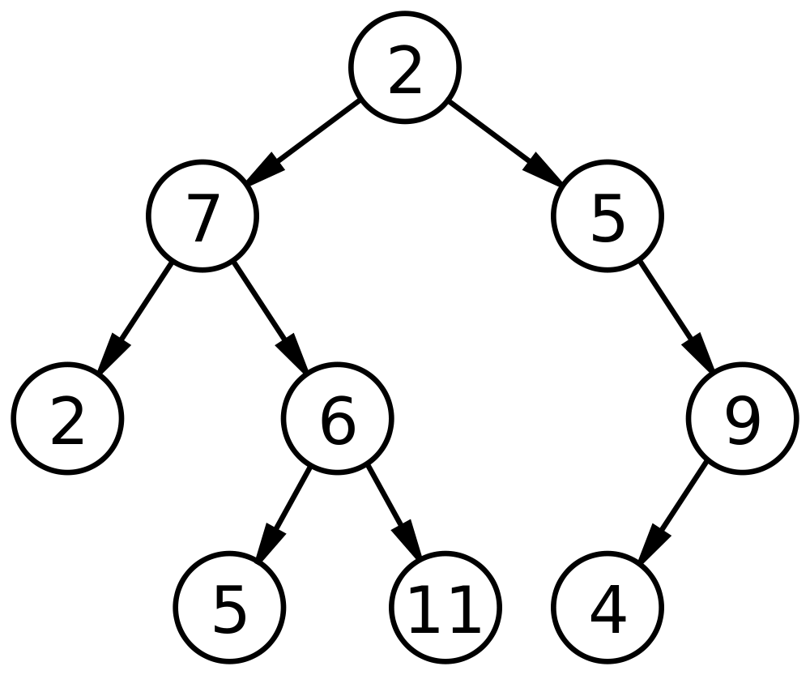
Binary Tree
A binary tree is a tree data structure in which each node has at most two children, which are referred to as the left child and the right child.

Slide 3
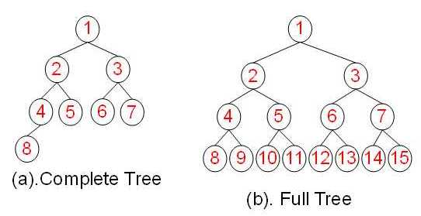
Types of Binary Trees
Complete Binary Tree:
In a complete binary tree every level, except possibly the last, is completely filled, and all nodes in the last level are as far left as possible.
Full Binary Tree:
A full binary tree (sometimes referred to as a proper or plane binary tree) is a tree in which every node has either 0 or 2 children.

Slide 4
Binary Tree Traversals
Tree Traversal: Process of visiting (checking and/or updating) each node in a tree data structure, exactly once.

Slide 5
Binary Tree Traversals
Tree Traversal: Process of visiting (checking and/or updating) each node in a tree data structure, exactly once.
Unlike linked lists, one-dimensional arrays etc., which are canonically traversed in linear order, trees may be traversed in multiple ways. They may be traversed in depth-first or breadth-first order.

Slide 6
Binary Tree Traversals
Tree Traversal: Process of visiting (checking and/or updating) each node in a tree data structure, exactly once.
Unlike linked lists, one-dimensional arrays etc., which are canonically traversed in linear order, trees may be traversed in multiple ways. They may be traversed in depth-first or breadth-first order.
There are three common ways to traverse them in depth-first order: in-order, pre-order and post-order.

Slide 7
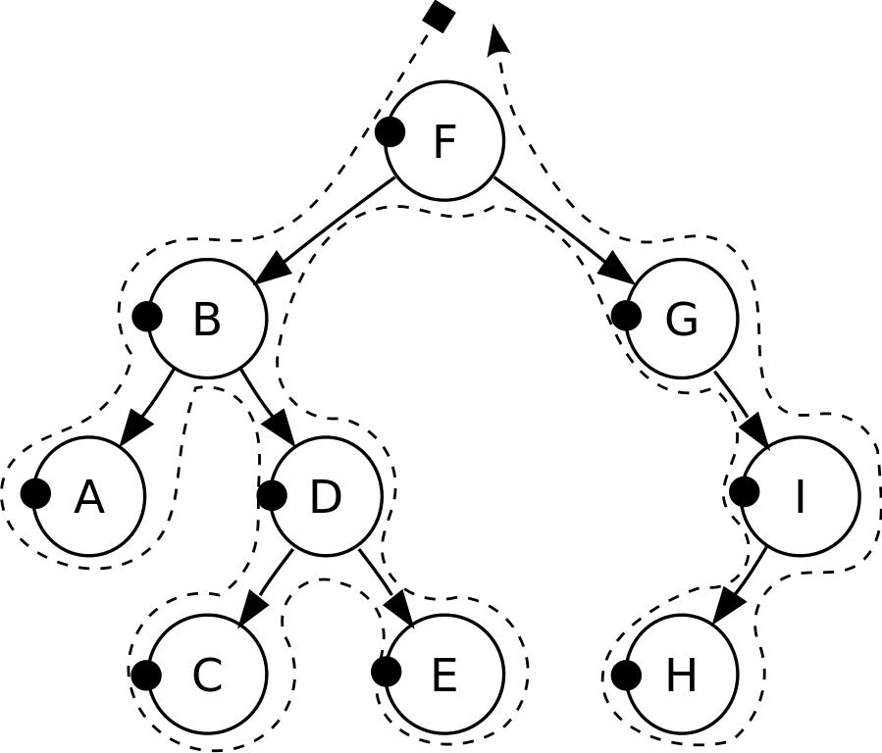
Pre-order Traversal
Check if the current node is empty / null.
Display the data part of the root (or current node).
Traverse the left subtree by recursively calling the pre-order function.
Traverse the right subtree by recursively calling the pre-order function.
Pre-order: F, B, A, D, C, E, G, I, H.

Slide 8
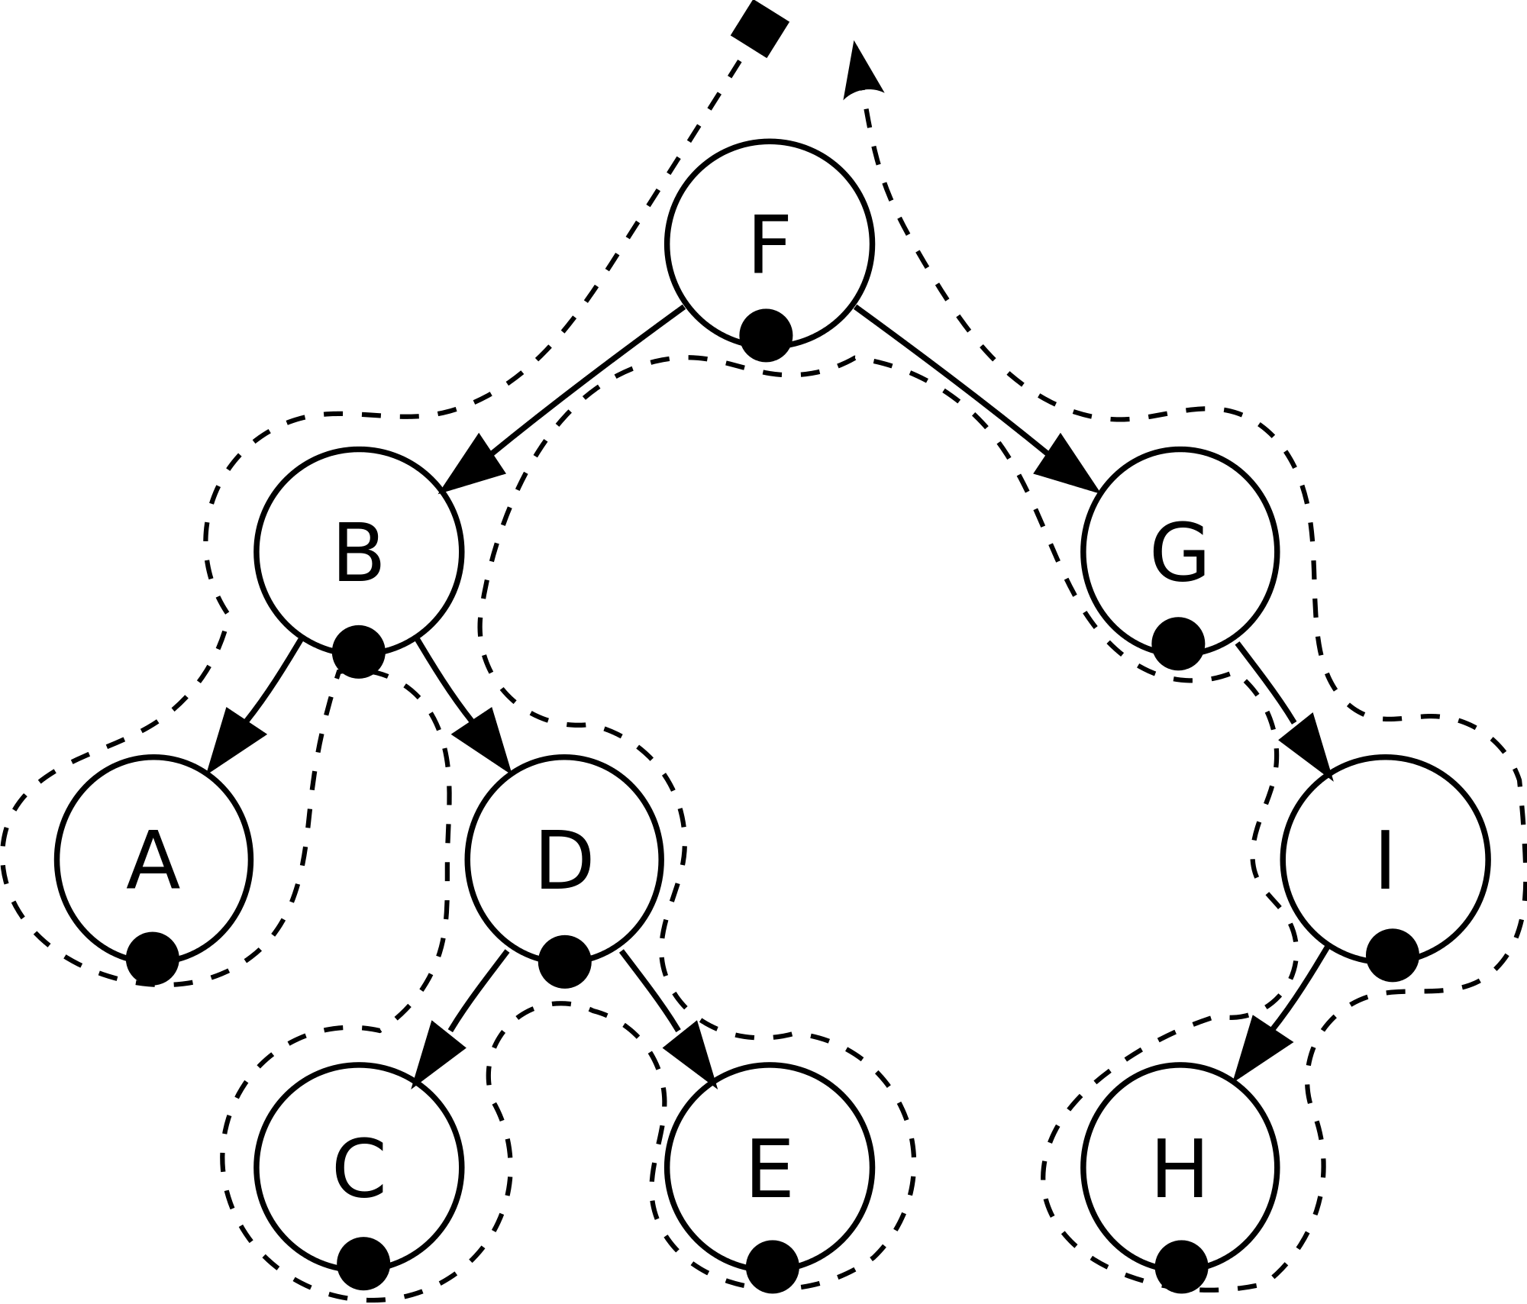
In-order Traversal
Check if the current node is empty / null.
Traverse the left subtree by recursively calling the in-order function.
Display the data part of the root (or current node).
Traverse the right subtree by recursively calling the in-order function.
In-order: A, B, C, D, E, F, G, H, I.

Slide 9

Post-order Traversal
Check if the current node is empty / null.
Traverse the left subtree by recursively calling the post-order function.
Traverse the right subtree by recursively calling the post-order function.
Display the data part of the root (or current node).
Post-order: A, C, E, D, B, H, I, G, F.

Slide 10
Level-order Traversal

Slide 11
Level-order traversal
Level-order traversal:
1,2,3,4,5
1
2
3
4
5

Slide 12
Level-order traversal
Level-order traversal:
1,
1
2
3
4
5
1

Slide 13
Level-order traversal
1
2
2
3
1
4
5
3

Slide 14
Level-order traversal
Level-order traversal:
1,2
1
2
3
4
5
2
3

Slide 15
Level-order traversal
1
4
2
3
2
4
5
5
3

Slide 16
Level-order traversal
Level-order traversal:
1,2,3
1
2
3
4
5
3
4
5

Slide 17
Level-order traversal
Level-order traversal:
1,2,3,4
1
2
3
3
4
5
4
5

Slide 18
Level-order traversal
Level-order traversal:
1,2,3,4,5
1
2
3
4
4
5
5

Slide 19
Level-order traversal
1
2
3
5
4
5

Slide 20
Reverse Level-order Traversal

Slide 21
Reverse Level-order traversal
Reverse Level-order traversal:
4,5,2,3,1
1
2
3
4
5

Slide 22
Reverse Level-order traversal
1
2
3
4
5
1

Slide 23
Reverse Level-order traversal
1
2
3
2
1
4
5
3
1

Slide 24
Reverse Level-order traversal
1
2
3
4
5
3
2
1

Slide 25
Reverse Level-order traversal
1
2
3
3
3
4
5
2
1

Slide 26
Reverse Level-order traversal
1
2
3
4
5
3
2
1

Slide 27
Reverse Level-order traversal
1
2
3
4
2
4
5
5
2
3
1

Slide 28
Reverse Level-order traversal
1
2
3
4
5
2
3
5
4
1

Slide 29
Reverse Level-order traversal
1
2
3
5
4
5
5
2
3
4
1

Slide 30
Reverse Level-order traversal
1
2
3
4
4
4
5
5
2
3
1

Slide 31
Reverse Level-order traversal
1
4
2
3
4
5
5
2
3
1

Slide 32
Reverse Level-order traversal
1
4
5
2
3
4
5
2
3
1

Slide 33
Reverse Level-order traversal
4
5
2
1
2
3
4
5
3
1

Slide 34
Reverse Level-order traversal
4
5
2
3
1
2
3
4
5
1

Slide 35
Reverse Level-order traversal
4
5
2
3
1
1
2
3
4
5

Slide 36
Size of Binary Tree

Slide 37
Calculate Size of Binary Tree
1
Size of Tree:
The total number of nodes in the tree.
2
3
4
5

Slide 38
Size of Binary Tree
Size: 1
1
2
3
4
5
1

Slide 39
Size of Binary Tree
1
2
2
3
1
4
5
3

Slide 40
Size of Binary Tree
Size: 3
1
2
3
4
5
2
3

Slide 41
Size of Binary Tree
1
4
2
3
2
4
5
5
3

Slide 42
Size of Binary Tree
Size: 5
1
2
3
4
5
3
4
5

Slide 43
Size of Binary Tree
Size: 5
1
2
3
3
4
5
4
5

Slide 44
Size of Binary Tree
Size: 5
1
2
3
4
4
5
5

Slide 45
Size of Binary Tree
Size: 5
1
2
3
5
4
5

Slide 46
Height of Binary Tree

Slide 47
Calculate Height of Binary Tree
1
Height of Tree:
The height of a tree is the height of its root node.
Height of Node:
The height of a node is the number of edges on the longest path between that node and a leaf.
2
3
4
5

Slide 48
Calculate Height of Binary Tree
2
1
Height of Tree:
The height of a tree is the height of its root node.
Height of Node:
The height of a node is the number of edges on the longest path between that node and a leaf.
1
2
0
3
0
0
4
5

Slide 49
def height(node):
if node is None:
return -1
left_height = height(node.left)
right_height = height(node.right)
return 1 + max(left_height, right_height)
2
1
1
0
2
3
0
0
4
5
node:
left_height
right_height

Slide 50
def height(node):
if node is None:
return -1
left_height = height(node.left)
right_height = height(node.right)
return 1 + max(left_height, right_height)
1
2
3
4
5
node:
left_height
right_height
1

Slide 51
def height(node):
if node is None:
return -1
left_height = height(node.left)
right_height = height(node.right)
return 1 + max(left_height, right_height)
1
2
3
4
5
node:
left_height
right_height
1

Slide 52
def height(node):
if node is None:
return -1
left_height = height(node.left)
right_height = height(node.right)
return 1 + max(left_height, right_height)
1
2
3
4
5
node:
left_height
right_height
1
2

Slide 53
def height(node):
if node is None:
return -1
left_height = height(node.left)
right_height = height(node.right)
return 1 + max(left_height, right_height)
1
2
3
4
5
node:
left_height
right_height
1
2

Slide 54
def height(node):
if node is None:
return -1
left_height = height(node.left)
right_height = height(node.right)
return 1 + max(left_height, right_height)
1
2
3
4
5
node:
left_height
right_height
1
2
4

Slide 55
def height(node):
if node is None:
return -1
left_height = height(node.left)
right_height = height(node.right)
return 1 + max(left_height, right_height)
1
2
3
4
5
node:
left_height
right_height
1
2
4

Slide 56
def height(node):
if node is None:
return -1
left_height = height(node.left)
right_height = height(node.right)
return 1 + max(left_height, right_height)
1
2
3
4
5
node:
left_height
right_height
1
2
4
None
-1

Slide 57
def height(node):
if node is None:
return -1
left_height = height(node.left)
right_height = height(node.right)
return 1 + max(left_height, right_height)
1
2
3
4
5
node:
left_height
right_height
1
2
4
None
-1

Slide 58
def height(node):
if node is None:
return -1
left_height = height(node.left)
right_height = height(node.right)
return 1 + max(left_height, right_height)
1
2
3
4
5
node:
left_height
right_height
1
2
4
None
-1
-1

Slide 59
def height(node):
if node is None:
return -1
left_height = height(node.left)
right_height = height(node.right)
return 1 + max(left_height, right_height)
1
2
3
4
5
node:
left_height
right_height
1
2
4
None
-1
-1

Slide 60
def height(node):
if node is None:
return -1
left_height = height(node.left)
right_height = height(node.right)
return 1 + max(left_height, right_height)
1
2
3
0
4
5
node:
left_height
right_height
1
2
4

Slide 61
def height(node):
if node is None:
return -1
left_height = height(node.left)
right_height = height(node.right)
return 1 + max(left_height, right_height)
1
2
3
0
4
5
node:
left_height
right_height
1
2

Slide 62
def height(node):
if node is None:
return -1
left_height = height(node.left)
right_height = height(node.right)
return 1 + max(left_height, right_height)
1
2
3
0
4
5
node:
left_height
right_height
1
2
5

Slide 63
def height(node):
if node is None:
return -1
left_height = height(node.left)
right_height = height(node.right)
return 1 + max(left_height, right_height)
1
2
3
0
4
5
node:
left_height
right_height
1
2
5

Slide 64
def height(node):
if node is None:
return -1
left_height = height(node.left)
right_height = height(node.right)
return 1 + max(left_height, right_height)
1
2
3
0
4
5
node:
left_height
right_height
1
2
5
None
-1

Slide 65
def height(node):
if node is None:
return -1
left_height = height(node.left)
right_height = height(node.right)
return 1 + max(left_height, right_height)
1
2
3
0
4
5
node:
left_height
right_height
1
2
5
None
-1

Slide 66
def height(node):
if node is None:
return -1
left_height = height(node.left)
right_height = height(node.right)
return 1 + max(left_height, right_height)
1
2
3
0
4
5
node:
left_height
right_height
1
2
5
None
-1
-1

Slide 67
def height(node):
if node is None:
return -1
left_height = height(node.left)
right_height = height(node.right)
return 1 + max(left_height, right_height)
1
2
3
0
4
5
node:
left_height
right_height
1
2
5
None
-1
-1

Slide 68
def height(node):
if node is None:
return -1
left_height = height(node.left)
right_height = height(node.right)
return 1 + max(left_height, right_height)
1
2
3
0
0
4
5
node:
left_height
right_height
1
2
5

Slide 69
def height(node):
if node is None:
return -1
left_height = height(node.left)
right_height = height(node.right)
return 1 + max(left_height, right_height)
1
2
3
0
0
4
5
node:
left_height
right_height
1
2

Slide 70
def height(node):
if node is None:
return -1
left_height = height(node.left)
right_height = height(node.right)
return 1 + max(left_height, right_height)
1
1
2
3
0
0
4
5
node:
left_height
right_height
1
2

Slide 71
def height(node):
if node is None:
return -1
left_height = height(node.left)
right_height = height(node.right)
return 1 + max(left_height, right_height)
1
1
2
3
0
0
4
5
node:
left_height
right_height
1
1

Slide 72
def height(node):
if node is None:
return -1
left_height = height(node.left)
right_height = height(node.right)
return 1 + max(left_height, right_height)
1
1
2
3
0
0
4
5
node:
left_height
right_height
1
1
3

Slide 73
def height(node):
if node is None:
return -1
left_height = height(node.left)
right_height = height(node.right)
return 1 + max(left_height, right_height)
1
1
2
3
0
0
4
5
node:
left_height
right_height
1
1
3
None

Slide 74
def height(node):
if node is None:
return -1
left_height = height(node.left)
right_height = height(node.right)
return 1 + max(left_height, right_height)
1
1
2
3
0
0
4
5
node:
left_height
right_height
1
1
3
None
-1

Slide 75
def height(node):
if node is None:
return -1
left_height = height(node.left)
right_height = height(node.right)
return 1 + max(left_height, right_height)
1
1
2
3
0
0
4
5
node:
left_height
right_height
1
1
3
None
-1

Slide 76
def height(node):
if node is None:
return -1
left_height = height(node.left)
right_height = height(node.right)
return 1 + max(left_height, right_height)
1
1
2
3
0
0
4
5
node:
left_height
right_height
1
1
3
None
-1
-1

Slide 77
def height(node):
if node is None:
return -1
left_height = height(node.left)
right_height = height(node.right)
return 1 + max(left_height, right_height)
1
1
0
2
3
0
0
4
5
node:
left_height
right_height
1
1
3

Slide 78
def height(node):
if node is None:
return -1
left_height = height(node.left)
right_height = height(node.right)
return 1 + max(left_height, right_height)
2
1
1
0
2
3
0
0
4
5
node:
left_height
right_height
1
1
0

Slide 79
def height(node):
if node is None:
return -1
left_height = height(node.left)
right_height = height(node.right)
return 1 + max(left_height, right_height)
2
1
1
0
2
3
0
0
4
5
node:
left_height
right_height

Slide 80
Pre-order Iterative

Slide 81
Pre-order Iterative
1
Pre-order output:
[1,2,4,5,3]
2
3
4
5

Slide 82
Pre-order traversal
Pre-order traversal:
1,
1
2
3
4
5
1

Slide 83
Pre-order traversal
Pre-order traversal:
1,2
1
2
3
4
5
1
2

Slide 84
Pre-order traversal
Pre-order traversal:
1,2,4
1
2
3
4
5
1
2
4

Slide 85
Pre-order traversal
Pre-order traversal:
1,2,4
1
2
3
4
5
1
2
4

Slide 86
Pre-order traversal
Pre-order traversal:
1,2,4
1
2
3
4
5
4
1
2

Slide 87
Pre-order traversal
Pre-order traversal:
1,2,4
1
2
3
4
5
1
2

Slide 88
Pre-order traversal
Pre-order traversal:
1,2,4,5
1
2
3
4
5
1
2

Slide 89
Pre-order traversal
Pre-order traversal:
1,2,4,5
1
2
3
4
5
1
2

Slide 90
Pre-order traversal
Pre-order traversal:
1,2,4,5
1
2
3
4
5
1
2

Slide 91
Pre-order traversal
Pre-order traversal:
1,2,4,5
1
2
3
4
5
1
2

